Slide 1
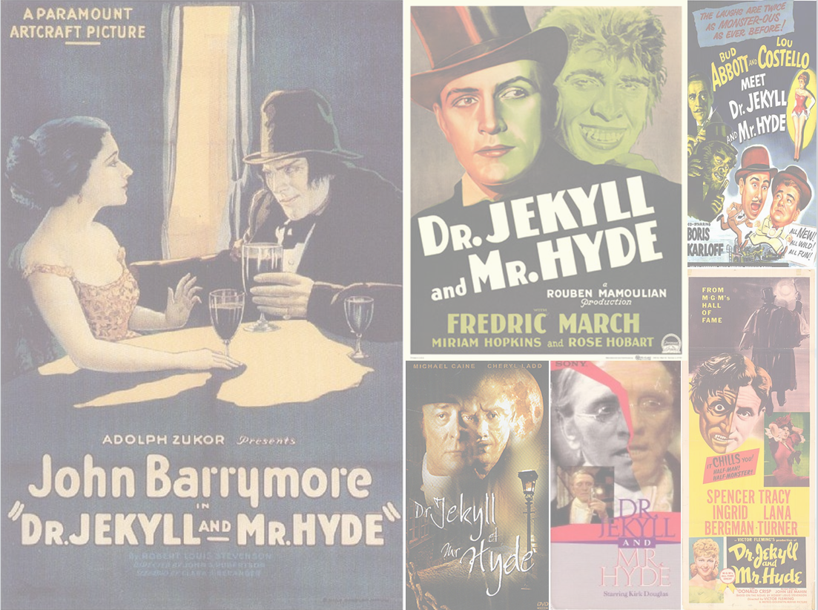
The Good and Bad of Documentation
Lessons to Learn from an Iffy PowerPoint Presentation

Slide 2
Introduction
A PowerPoint presentation recently sent to me illustrates the good and bad of documentation because its slides contain examples of both
The focus here is on consistency among slides
Separately, we will address the most egregious sin of PowerPoint presentations—jamming ten pounds of content into a five pound slide—but not today

Slide 3
Good Doc Habits
General Writing Consistency
Fonts
Usage
Layout
Terminology
Emphasis
PowerPoint has four consistency areas of concern
End of bullet punctuation
Slide layout and design
Image dimensions and placement
Animations

Slide 4
PowerPoint Areas of Concern
End of Bullet Punctuation
Either they all end in periods or they all don’t (PERIOD!)
Commas and semicolons need not apply
Slide Design and Layout
Design is the color scheme, fonts, and placements
The design should be the same for all slides except for the title and individual section titles
Layout is the individual slide organization
This can vary depending on the content, but similar slides should have the same layout

Slide 5
PowerPoint Areas of Concern (cont’d)
Image Dimensions and Placement
As much as possible, make images the same dimensions to help the viewer
Images should always begin at the same horizontal location unless the image cannot otherwise fit because it is jarring for the viewer when they jump horizontally between slides
Vertical differences are not as jarring especially if the horizontal is the same

Slide 6
PowerPoint Areas of Concern (cont’d)
Animations
Everyone loves to play with animations and make things fly in and dissolve and spin, but pretty soon the viewer has serious vertigo
Keep it simple and consistent because the animations are there to emphasize the content not be the content
With luck, there will be one opportunity to be flashy and it will stand out more than if the entire presentation looks like it OD’d on Caf-Pow

Slide 7
Slice and Dice Time
We will look at six slides of the presentation to point out the good and bad (mostly bad)
Various animations both highlight the slide issues and demonstrate the animations themselves
Each animation is annotated with its type and settings
Watch how they behave and interact with slide content
Modify as you like with small tweaks or wholesale substitutions to gain a better understanding of them

Slide 8
Slides From The Presentation

Slide 9
Meeting Agenda:
No punctuation should ever follow a title (Animation: Arrow appear on click, textbox appear .3 seconds after)
Opening Remarks
Global Cap Update
Work Group Process
Next Steps
Basic Benefit Review Work Group
Workforce Flexibility and Change of Scope
Payment Reform Work Group
Note: Each Work Group will be given one hour to discuss its final recommendations (presentation, discussion, and vote).
9

Slide 10
Program Global Spending Cap 2011-12
It’s not that you cannot use vertical page numbers, but you need to use them on every slide.(Animation: Both fly in right, text .3 seconds after)
10

Slide 11
Notice the jump from the last slide because the table started farther to the left. It feels jarring. Use the wheel to go back and forth between the slides.
(Animation: Both plus, text 1 second later)
Program Spending April through October 2011
(dollars in thousands)
Category of Service | Estimated | Actual | Variance
Counseling | $1,225,075 | $1,216,997 | ($8,078)
Emergency | $205,642 | $181,398 | ($24,244)
Supplies | $180,963 | $184,660 | $3,697
On-site Visits | $1,899,661 | $1,864,284 | ($35,377)
Extended Engagement | $1,097,521 | $1,054,679 | ($42,841)
Third Party Providers | $2,032,365 | $2,030,542 | ($1,824)
New Initiatives | $395,475 | $429,944 | $34,469
Institutional | $2,427,927 | $2,334,197 | ($93,730)
Cash Audits | ($199,071) | ($155,857) | $43,214
TOTAL | $9,265,558 | $9,140,844 | ($124,714)
11

Slide 12
Enrollment
Program enrollment reached 4,991,840 enrollees at the end of October 2011. This reflects an increase of 101,500 enrollees, or 2.0%, since April 2011.
Now notice the lack of a jump from the last slide because the image is lined up with the table. It feels smooth.
(Animation: Both wipe left, text 1 second later)
12

Slide 13
Next Steps
To punctuate…
(Animation: Group object, wipe from top slow)
An Action Plan has been drafted by staff for transmittal by December 31
This report will include a summary of Phase 1 reforms and the approved recommendations.
The combined product will establish a comprehensive action plan for the program.
The plan will be the most significant overhaul of the program since its inception.
Report will be shared with team members as a draft prior to being finalized
Or not to punctuate.
(Animation: Group object, wipe from bottom medium instead of slow because only two arrows)
13

Slide 14
Program Final Report - Timeline
12/14: Final draft report emailed to program members for review
12/20: Comments and suggestions due from program members
Comments will be reviewed and report will be updated.
12/31: Program Final Report submitted
Final report will also be emailed to members and made available on program website.
Suddenly, the slide number is horizontal. (Animation: Both fly in right, text .3 seconds after)
14

Slide 15
Conclusion
Over the six slides we looked at, you have gotten an idea of how not to do things in PowerPoint and writing, in general
You have also seen examples of PowerPoint animations designed to make you go, “I like that,” or “Make it stop”
We will discuss all of this and more in our follow-up training session

